Slide 1


Predict Air Pressure system failure
Rama Danda
DSC 680 - Summer 2021

Slide 2
Domain Background
Predict Air Pressure systems(APS) failure used in Scania trucks
System is used for Braking and gear changes
Data set is readings from sensors in the system from everyday use
Positive and negative class if failure caused by APS or not

Slide 3
Domain use case
Prevent maintenance checks not required
Reduce trucking business down time because of failure
Eliminate costly work required while hauling time bound deliveries

Slide 4
Data sources
Data sources is through UCI Machine Learning Repository
Data source links:
https://archive.ics.uci.edu/ml/datasets/APS+Failure+at+Scania+

Slide 5
Defining the features & Target Variable
171 features are numerical and histogram bins data and is anonymized for proprietary reasons
Target label
Positive class failure is due to component of the APS
Negative class failure is not related to APS

Slide 6
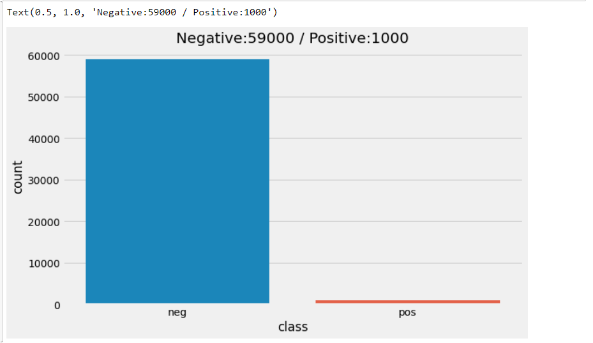
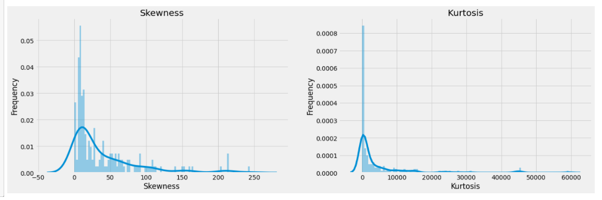
EDA
First graph EDA show Class distribution which is highly unbalanced dataset with positive and negative class.
Second graph show skewness to the left, while left tailed relative to the normally distributed from the kurtosis graph.

Slide 7
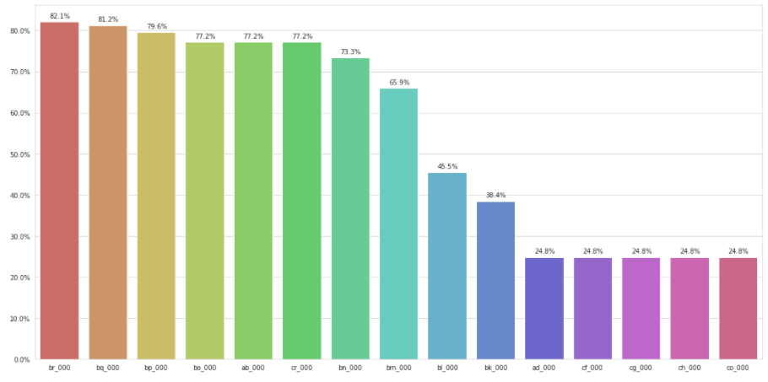
EDA
Null validation EDA shows 80% missing and while other are close to 50% values missing.
Removed the top 10 features that has n/a values

Slide 8
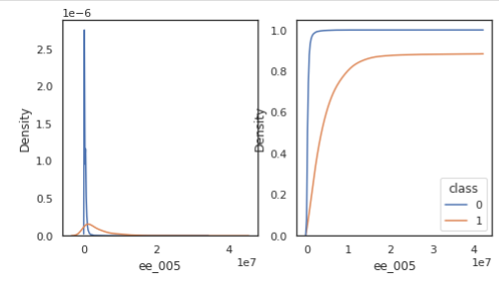
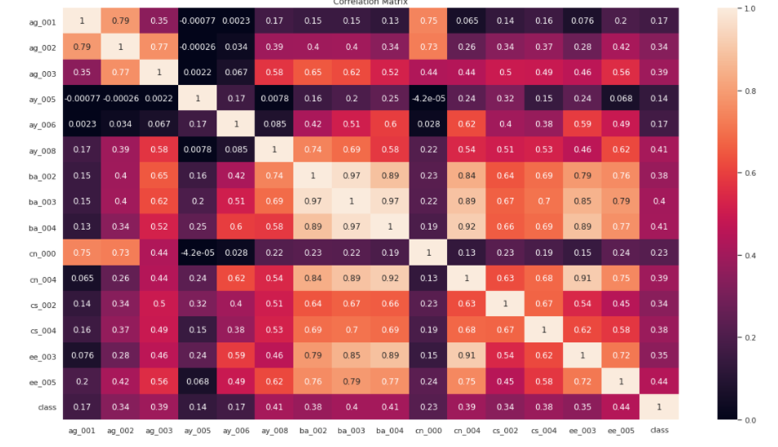
EDA
Density plots of the features ag_001 and ay_005 reveals the values of these two features lead to higher APS failure.
ee_005 and ba_004,cn_004,cs_004 has higher correlation to the class. ag_002, ag_001 & cn_000 has high degrees of failure in the APS

Slide 9
Standardization & Transformation
MinMax Scalar transformation
SMOTE method to balance the data resulted in 33k -0’s and 16k -1’s

Slide 10
Model building
F1 score as the measure to measure each model of
Logistic Regression
SGD Classifier
Decision Tree Classifier
AdaBoost

Slide 11
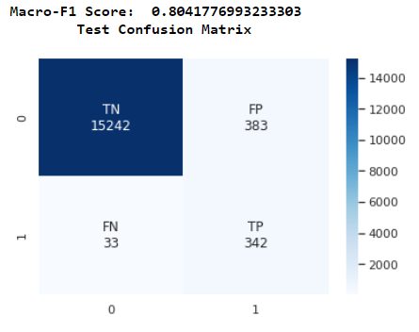

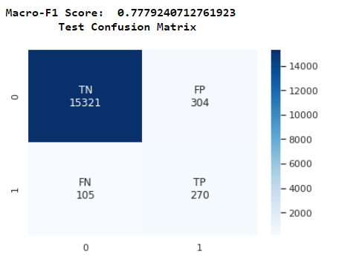
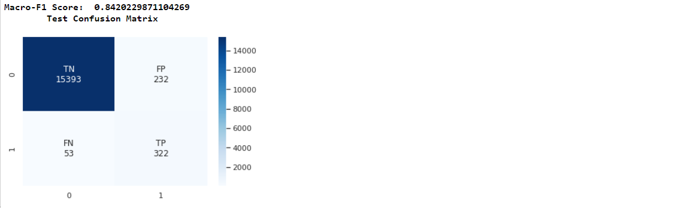
Modeling & Results
Logistic Regression – 0.804
SGD Classifier – 0.768
Decision Tree Classifier – 0.777
AdaBoost – 0.84

Slide 12
Model parameters
All the models are passed with the same set of 10-fold cross validation as a fixed
Parameter C is the hyper parameter used to combat the highly imbalanced dataset
Based on these three models, Adaboost with 0.84 F1 score performed best.

Slide 13
Conclusion & next steps
Data cleansing and standardization
Expensive computations for building models
Build more models using Keras

Slide 14
Acknowledgements & References:
1)Industrial Challenge: Using Machine Learning for Predicting Failures
https://www.researchgate.net/publication/313065916_IDA_2016_Industrial_Challenge_Using_Machine_Learning_for_Predicting_Failures
2) Combining Boosted Trees with Metafeature Engineering for Predictive Maintenance
https://repositorio.inesctec.pt/bitstream/123456789/4388/1/P-00K-WFP.pdf
3)Prediction of Failures in the Air Pressure System of Scania Trucks Using a Random Forest and Feature Engineering
https://www.researchgate.net/publication/309195602_Prediction_of_Failures_in_the_Air_Pressure_System_of_Scania_Trucks_Using_a_Random_Forest_and_Feature_Engineering

